Slide 1
Defining and Managing Project and Product Scope
Chapter 5
Leigh Jin
ISYS 663

Slide 2
Learning Objectives
Identify the five processes that support project scope management.
Describe the difference between product scope and project scope.
Apply several tools and techniques for defining and managing the project’s scope.

Slide 3
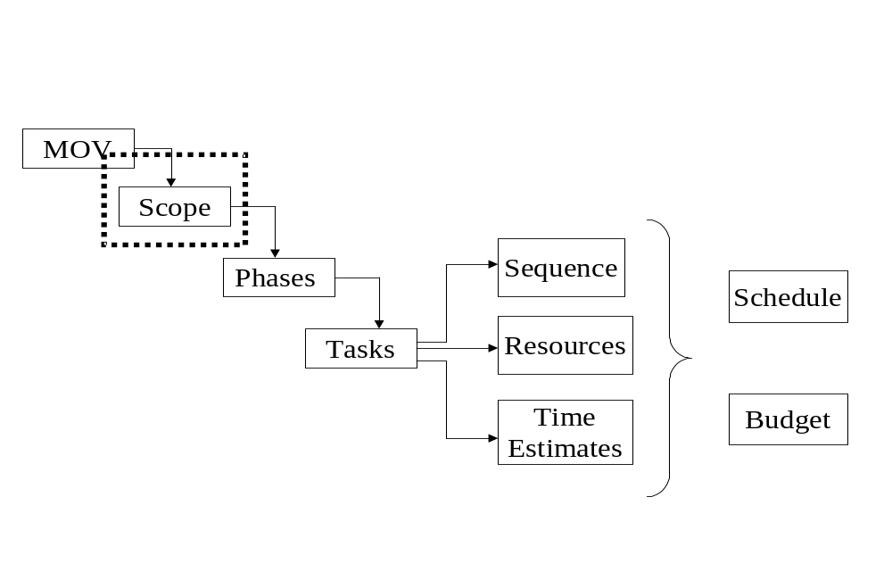
Project Planning Framework

Slide 4
Scope Management Plan
Collect Requirements
  Defining and documenting the customer, sponsor, or stakeholder needs and expectations. This may be a formal document.
Define Scope
  A detailed description of the product, service, or information system to be designed, built and implemented.
  Defines what work will and will not be part of the project and will serve as a basis for all future project decisions
Create the Work Breakdown Structure
  The decomposition or dividing of the project deliverables into smaller and more manageable components
Verify Scope
  Confirmation and formal acceptance that the project’s scope is accurate, complete, and supports the project’s MOV.
  The project team and sponsor must agree to all deliverables
Control Scope
  Ensuring that controls are in place to manage proposed scope changes.
  Must be communicated to all project stakeholders.

Slide 5
Scope Management Plan
Collect Requirements | Centers on defining and documenting the stakeholders’ needs to properly manage expectations
Define Scope | A detailed description of project and the product. It should define what work will and will not be included in the project.
Create Work Breakdown Structure (WBS) | The decomposition or dividing of the major project deliverables into smaller and more manageable components.
Verify Scope | Confirmation and formal acceptance that project’s scope is accurate, complete, and supports the project’s goal.
Control Scope | Ensuring that controls are in place to manage proposed scope changes one the project’s scope is accepted. These procedures must be communicated and understood by all project stakeholders.

Slide 6
Scope Planning
Defining and documenting the project work (i.e., deliverables) needed to achieve the project’s MOV
  Extra work that will not help the project achieve it’s MOV should be eliminated
This process begins at a high level and will become more detailed as the project progresses and more information becomes available
Attempts to answer the question:
  What is and what is not to be delivered by this project?
  Makes the project sponsor’s needs and expectations explicit
Tools:
  Scope Boundary
  Scope Statement

Slide 7
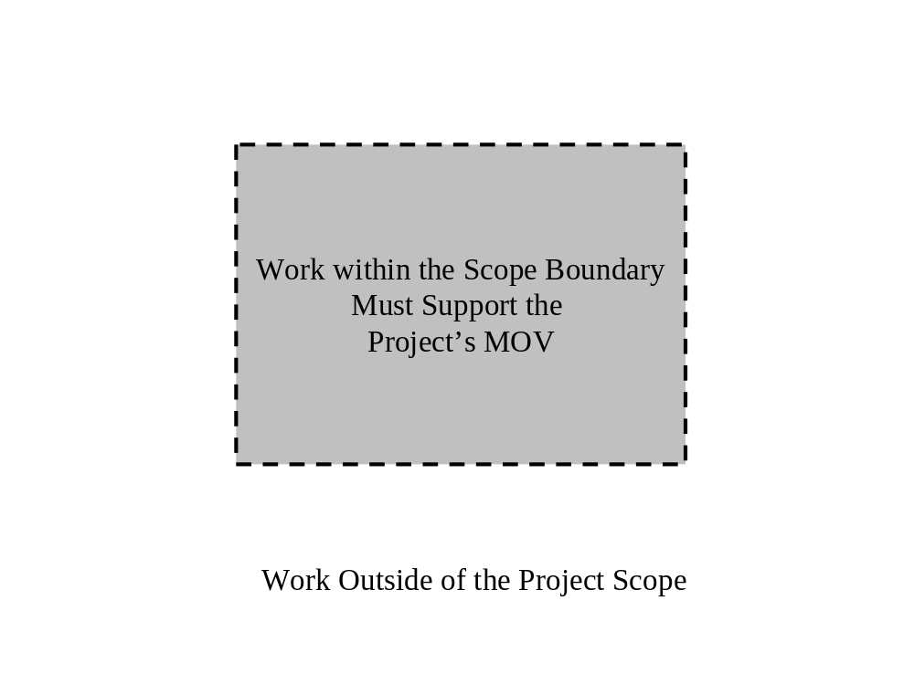
Scope Boundary

Slide 8
Statement of Work
Narrative description of the product, service, or information system.
For internal projects, this is tied to the business need
For external projects, this would include specifications, quantities, quality standards, and performance requirements for prospective bidders.

Slide 9
Scope Statement – An Example
Develop a proactive electronic commerce strategy that identifies the processes, products and services to be delivered through the World Wide Web.
Develop an application system that supports all of the processes, products, and services identified in the electronic commerce strategy.
The application system must integrate with the bank’s existing enterprise resource planning system.

Slide 10
Out of Scope
Technology and organizational assessment of the current environment
Customer resource management and data mining components

Slide 11
Project Scope Definition
The scope boundary and scope statement provide a useful first step
The project’s scope must now be defined in more detail in terms of specific deliverables that provide a basis for developing the project’s work breakdown structure (WBS)
Tools:
  Deliverable Definition Table
  Deliverable Structure Chart
  Context Level Data Flow Diagram
  Use Case Diagram

Slide 12
Scope
Project-Oriented Deliverables
  Support the project management and IT development processes defined in the Information Technology Project Methodology (ITPM).
  Tools
    Deliverable Definition Table (DDT)
    Deliverable Structure Chart (DSC)
Product-Oriented Deliverables
  Specific features and functionality of the application system
  First cut of requirements definition
  Tools
    Context Dataflow Diagram (DFD)
    Use Case Diagram (UCD)

Slide 13
Deliverable Definition Table (DDT)
Deliverable
Structure
Standards
Approval Needed By
Resources Required
Business Case
Document
As defined in the Project Methodology
Project Sponsor
Business Case Team, & office automation (OA) tools
Project Charter & Project Plan
Document
As defined in the Project Methodology
Project Sponsor
Project manager, project sponsor & OA tools
Current System Study
Document
As defined in the Project Methodology
Project Manager & Project Sponsor
Systems analysts users, case tool and OA tools

Slide 14
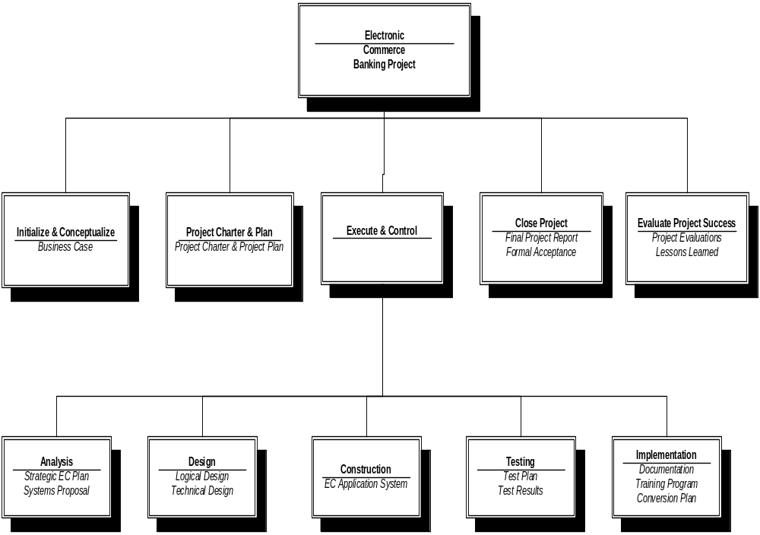
Deliverable
Structure
Chart

Slide 15
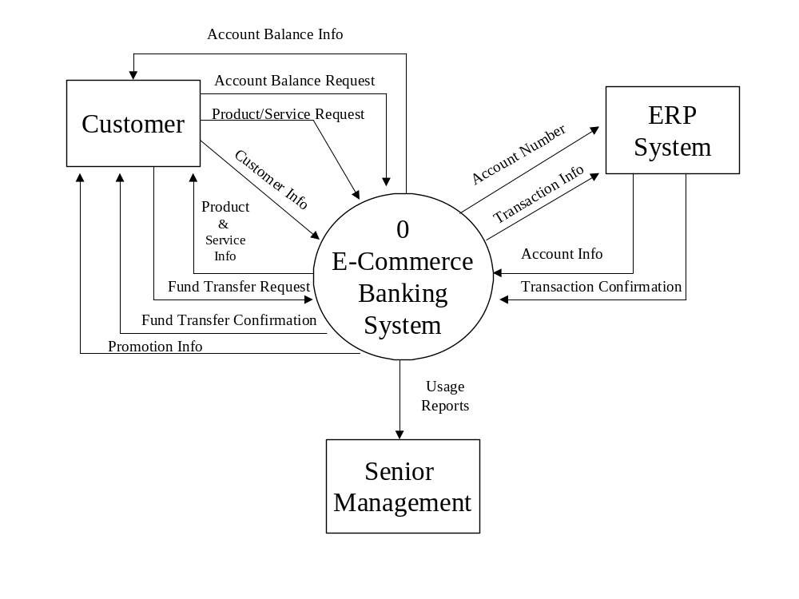
Context Data Flow Diagram

Slide 16
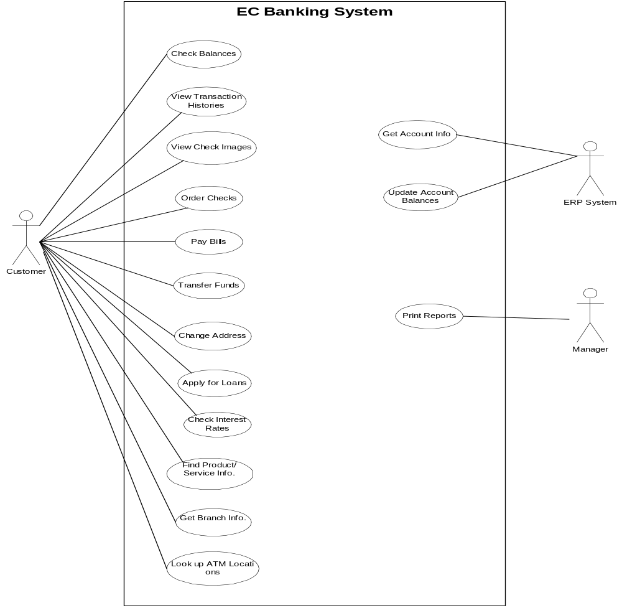
Use Case
Diagram

Slide 17
Project Scope Verification
MOV
  Has the project’s MOV been clearly defined and agreed upon?
Deliverables
  Are the deliverables tangible and verifiable?
  Do they support the project’s MOV?
Quality Standards
Milestones
  Significant events that mark the acceptance of a deliverable
Review and Acceptance
  Formal Signoff

Slide 18
Scope Change Control
Concerned with managing changes to the project’s scope and to ensure that these changes are beneficial when they occur
Mitigates:
  Scope Grope: inability to define
  Scope Creep: increasing featurism
  Scope Leap: fundamental change
Tools/Procedures:
  Scope Change Request Form
  Scope Change Request Log
Scope
Schedule
Budget

Slide 19
Scope Change Request Form
Requestor Name: _______________ Request Date: __________
Request Title: __________________ Request Number: _______
Request Description:
Justification:
Possible Alternatives:
Impacts
Alternative 1
Alternative 2
Alternative 3
Scope
Schedule
Resources Required
Cost
Recommendation:
Authorized By:
Date:

Slide 20
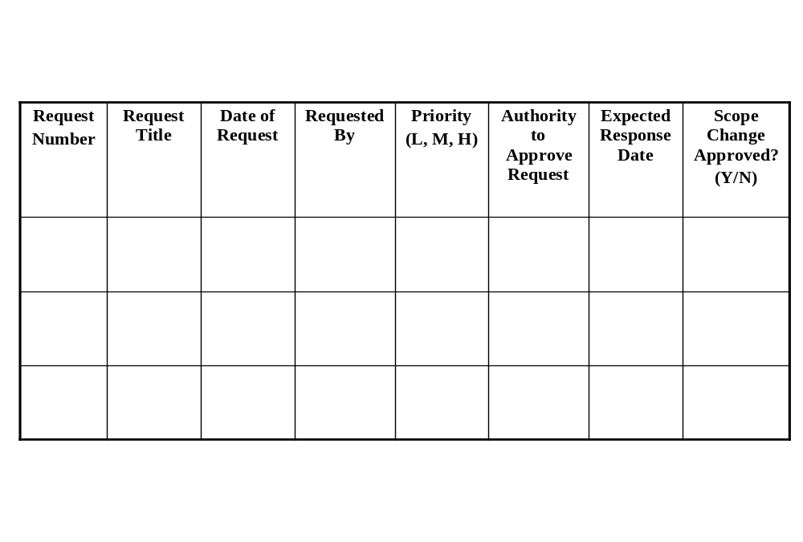
Scope Change Request Log

Slide 21
Benefits of Scope Control
Keeps the project manager in control of the project.
  Authorized changes to the project’s scope are reflected in changes to the project’s schedule and budget.
Allows the project team to stay focused and on track
  They do not have to perform unnecessary work.

